Slide 1
Typesafe Config on Steroids
@sourcedelica

Slide 2
Agenda
Introduction to Typesafe Config
Scopes – taking it to the next level

Slide 3
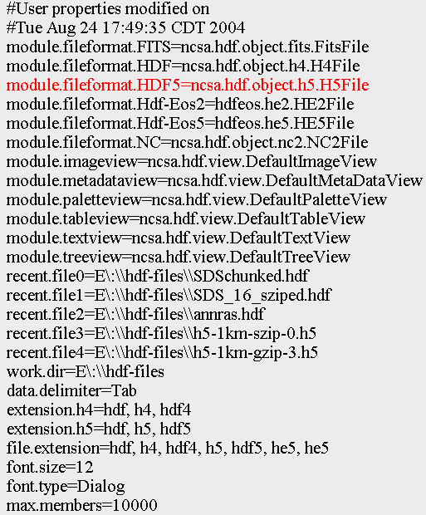
Property Files
The old standby
On JVM
Simple
Hard to scale

Slide 4
Apache Commons Configuration
Typed API
Substitutions
Include other files
Downsides
Limited by property file format
Composition is limited

Slide 5
Spring
Good integration of properties with DI
Environment abstraction
Compose sets of property files
Separate sets for Dev, Test, Production, etc.
Override with system properties
Spring Boot
Takes environment abstraction to next level
Supports YAML
Notes:
Downside (?) – requires Spring

Slide 6
Typesafe Config
Used by Play Framework and Akka
But is a standalone project with no dependencies
JSON-like format
Java API
Typed
Immutable
Power features
Notes:
Immutability is important when dealing with multiple configurations. You want to work with configurations as values.

Slide 7
Typesafe Config Format
HOCON
Human-Optimized Config Object Notation
# This is a configuration file
database {
username = "scott"
connections = 20
timeout = 5 seconds
}
jms.brokers =
["nyamq10", "sfamq20", "jpamq54" ]
Notes:
Comments are supported
This is a configuration file
Property referenced as database.username
Lists of values

Slide 8
External Values
System properties are used by default
Easy to override config values in scripts
Reference environment variables
Would override basedir if set
basedir = "/foo/bar/baz"
basedir = ${?BASEDIR_OVERRIDE}

Slide 9
API examples
# Loads all application.conf in the
# classpath
Config config = ConfigFactory.load()
String username =
config.getString("database.username")
int connections =
config.getInt("database.connections")

Slide 10
API Examples
# Values are like "15s", "5 minutes"
Duration timeout =
config.getDuration("database.timeout")
# Values are like "100m", "2 gigs"
long size =
config.getBytes("cache.size")
# A list of values
List<String> brokers =
config.getStringList("jms.brokers")

Slide 11
Create Configs at Runtime
val config =
ConfigFactory.parseString(
s"""
|akka {
| remote {
| netty.tcp {
| hostname = "$hostname"
| port = $port
| }
| }
|}
""".stripMargin)
Notes:
The triple-quotes is Scala syntax for multi-line string literal. It is also supported in HOCON – great for queries.

Slide 12
Config Objects
demo {
services = [
{ name = "user",
host = "nycdev101", port = 8080
}
{ name = "search",
host = "nycdev102", port = 9201 }
]
}
List<Config> configList =
config.getConfigList("demo.services")

Slide 13
Merging Configs
# System properties falling back to
# user configuration falling back to
# application configuration
Config finalConfig =
ConfigFactory.systemProperties().
withFallback(userConfig).
withFallback(appConfig).
resolve()
Notes:
System properties is the main configuration, falling back to the user config, and finally the app config
Base configs may contain substitutions that are resolved by other configs

Slide 14
Scopes Library
A library built on top of Typesafe Config
Adds
Multiple scopes of configuration
aka Configurable config merging
Pluggable resource handling
and more

Slide 15
Scopes Configuration
scopes = [
{
name = application
path = "classpath://config.conf"
}
{
name = shared
path = "zk://config/config.conf"
}
{
name = environment
path = "zk://config/${environ}.conf"
}
]
Notes:
Configs are merged from top to bottom
Placeholders are substituted with system properties
Resource locations are pluggable – here we see classpath and Zookeeper

Slide 16
Scopes API
Superset of Typesafe Config API
Adds
Scala API
Resource values
Defaults
Dynamic updates
and more

Slide 17
Extended API
demo {
jms.brokers =
["nyamq10", "sfamq20", "jpamq54" ]
}
val config = Scopes.config()
# Scala collections are used by default
config.getStringList("demo.jms.brokers").
foreach(println)
Notes:
There is a getStringListAsJava

Slide 18
Extended API
demo {
database.user = "scott"
database.password = "tiger"
}
val username =
config.getString("db.user", "admin")
# Returns Some[String] or None if not set
val password =
config.optString("db.password").
getOrElse("admin")
Notes:
Very handy to use options in some use cases

Slide 19
Resource Properties
demo {
# Current support: classpath, file, zk
helpText = "classpath://help.txt"
}
val helpResource =
config.getResource("demo.helpText")
val helpText = helpResource.asString
val helpStream = helpResource.asStream

Slide 20
Dynamic updates
Watches config locations defined in scopes
If changes are made, callbacks get new values

Slide 21
Interested?
Interested in Scopes?
I’m thinking of open-sourcing
Contact me @sourcedelica

Slide 22
More Info
Github
https://github.com/typesafehub/config
Javadoc
http://typesafehub.github.io/config/latest/api/
Intellij
Scala Plugin has editing support
Syntax checking, folding

